Slide 1
Series Peripheral Interface (SPI)
PHYS 398
Nayan Myerson-Jain, John Wang, Zhaoqi Wu, Steven Zhang
Notes:
Spi to i2c

Slide 2
Introduction of SPI
SPI was invented by Motorola in the 1980’s.
SPI is a synchronous serial communication interface primarily used in embedded systems (e.g. Arduino).
SPI devices communicate in full duplex mode (allow simultaneous data transmission in both directions) using a master-slave architecture
One master, multiple slave-devices through slave selection (SS).
4 signals: SCLK, MOSI, MISO, SS

Slide 3
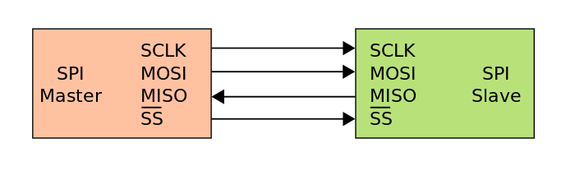
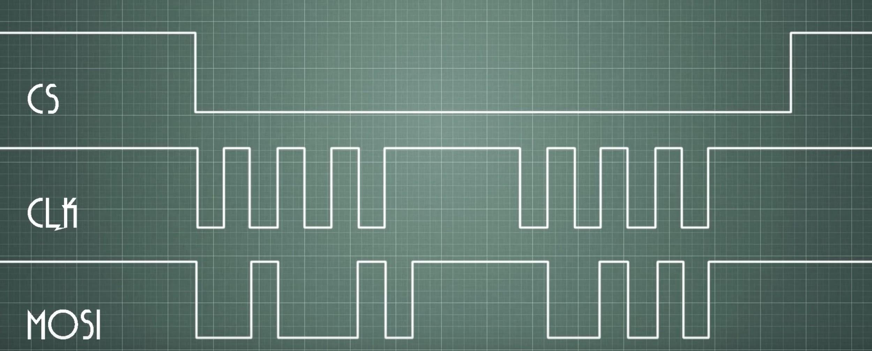
How Does SPI Work?
SCLK: Serial Clock (output from master)
MOSI: Master Output Slave Input (data output from master)
MISO: Master Input Slave Output (data output from slave)
SS: Slave Select
Notes:
SPI is a very simple communication protocol.
SCLK is generated by the master device and is used for synchronization. MOSI and MISO are the data lines. The direction of transfer is indicated by their names. Data is always transferred in both directions in SPI, but an SPI device interested in only transmitting data can choose to ignore the receive bytes. Likewise, a device only interested in the incoming bytes can transmit dummy bytes.
each slave needs its own SS, the number of traces required is n+3, where n is the number of SPI devices. This means increased board complexity when the number of slaves is increased.

Slide 4
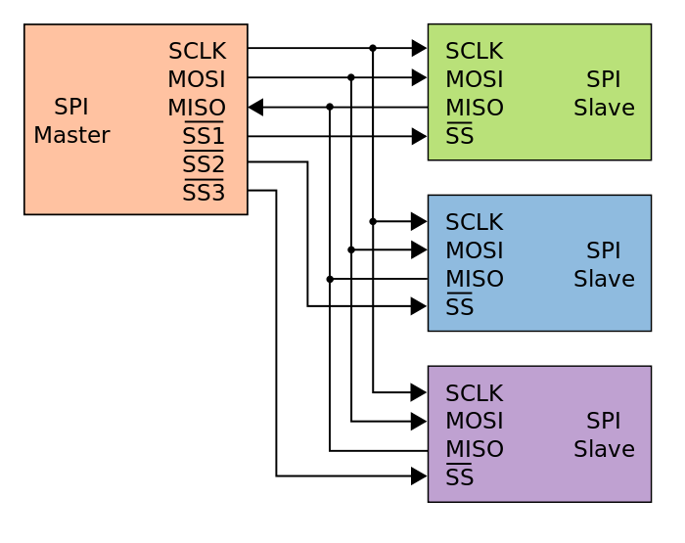

Slide 5
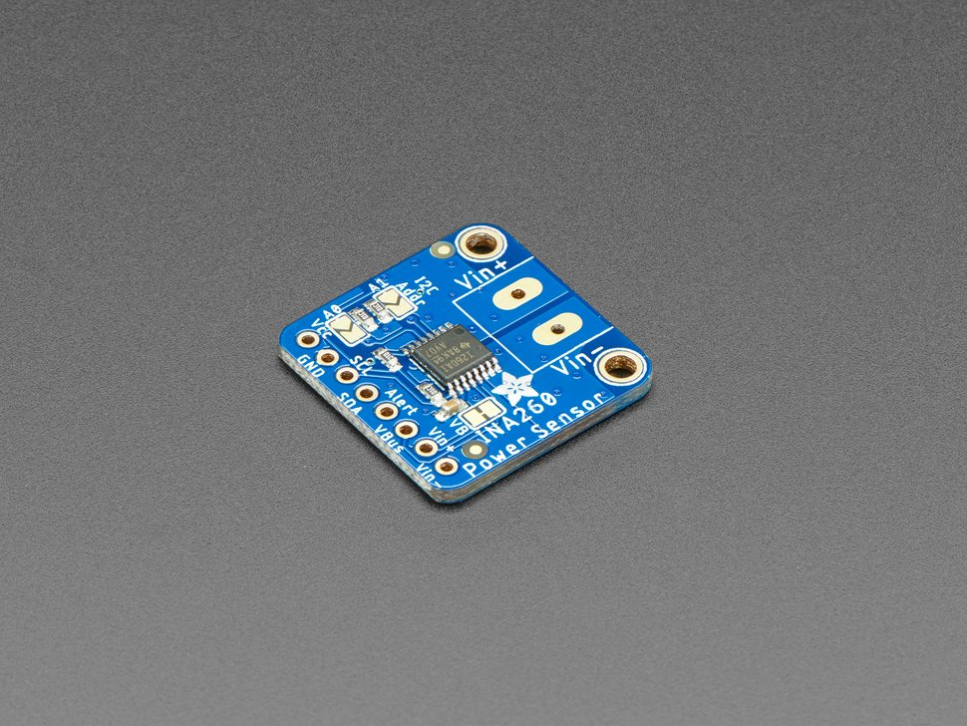
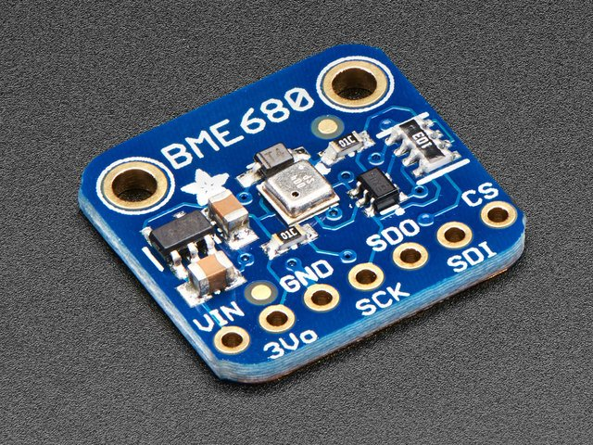
SPI vs I2C
SPI
I2C

Slide 6
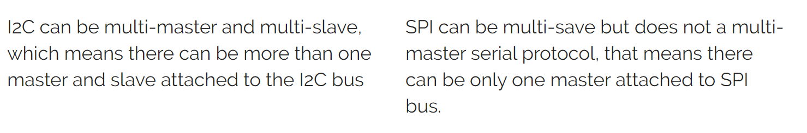
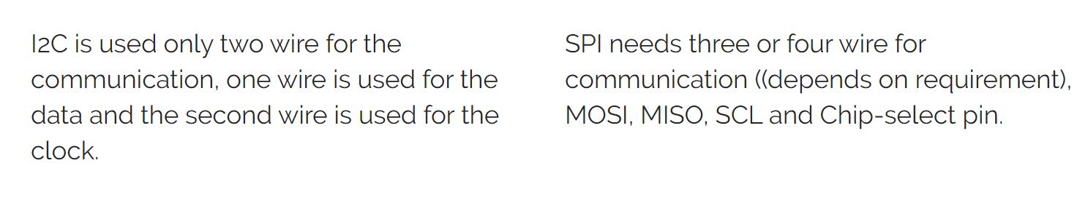
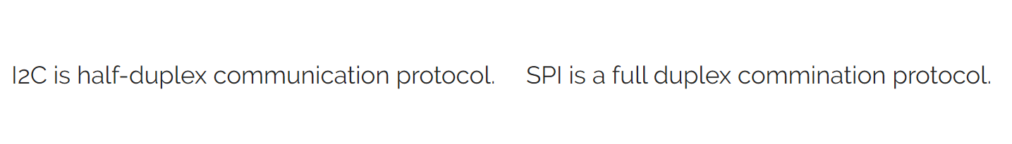
I2C
SPI

Slide 7
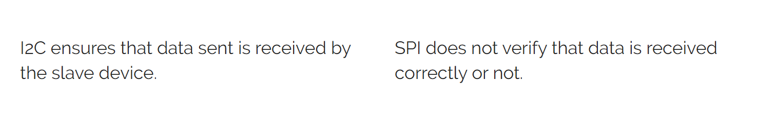


Pros and cons
I2C
SPI

Slide 8
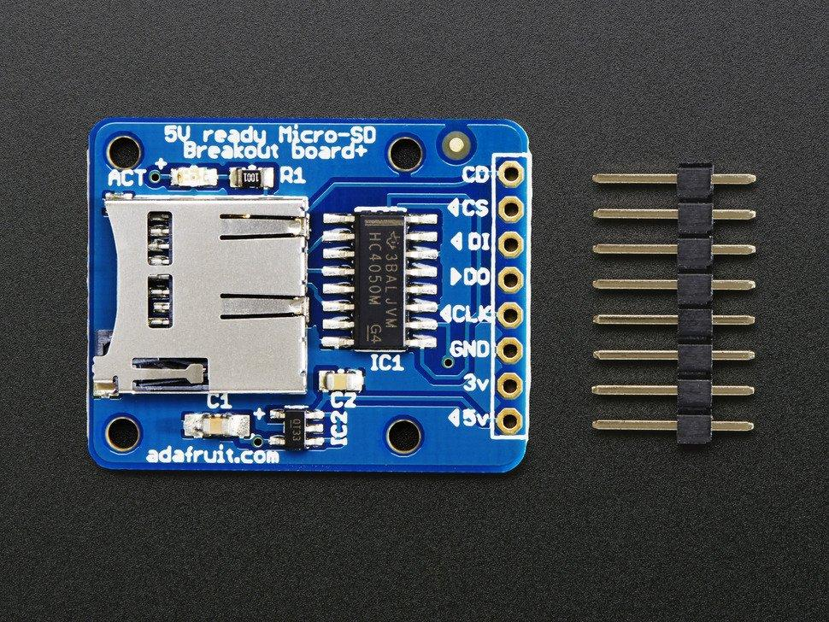
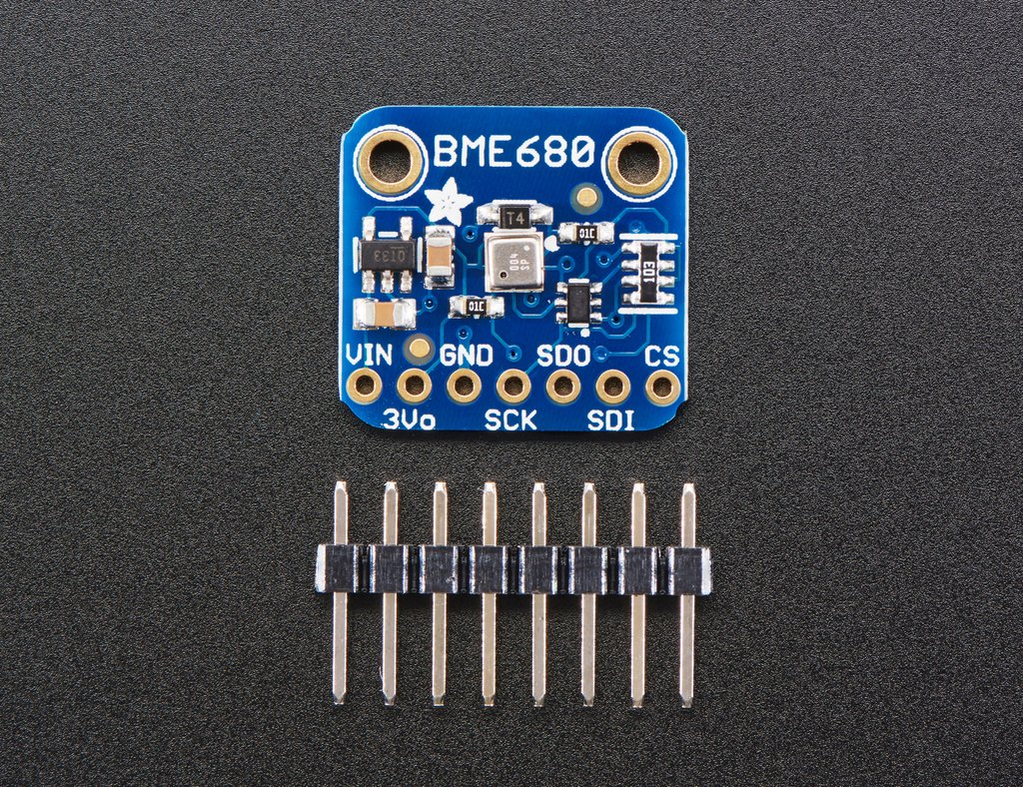
Applications of SPI
SPI has become the industry standard interface protocol for relatively simple devices that work well with only a single master and require fast data transfer.
Applications include: SD Cards, LCDs and LEDs, Temperature and Pressure.
It is also used in communication devices such as Ethernet controllers and USB controllers.
Not great for using many devices, since SPI requires 4 wires to interact with slaves.
Adafruit MicroSD Breakout Board
Adafruit BME680
Notes:
The applications for SPI are wide-ranging, but typically include SD cards, LCDs, and temperature and pressure sensors such as the ones that we’re using in class. Ethernet controllers are integrated circuit chips that allow computer to connect to the internet and USB controllers which allow your computer to interact with USB devices.

Slide 9
Reference
Olumodeji, O. A., & Gottardi, M. (2017). Arduino-controlled HP memristor emulator for memristor circuit applications. Integration: The VLSI Journal, 58, 438–445.
https://doi-org.proxy2.library.illinois.edu/10.1016/j.vlsi.2017.03.004
https://en.wikipedia.org/wiki/Serial_Peripheral_Interface
https://www.youtube.com/watch?v=IyGwvGzrqp8&t=215s
F. Leens, "An introduction to I2C and SPI protocols," in IEEE Instrumentation & Measurement Magazine, vol. 12, no. 1, pp. 8-13, February 2009.
https://www.arduino.cc/en/reference/SPI

